Slide 1
ENZYMES
Learninig Objectives:
1. Define enzymes.
2-Describe the biomedical importance of enzymes.
3. To illustrate the general properties of enzymatic reactions.

Slide 2
Enzymes :are proteins that increase the rate of chemical reaction by lowering the energy of activation but do not alter the equilibrium constants of the reaction they catalyze.
They catalyze nearly all the chemical reactions taking place in the cells of the body.
Not altered or consumed during reaction.
Reusable

Slide 3
Many enzymes require the presence of other compounds - cofactors - before their catalytic
activity can be exerted.
This entire active complex is referred to as the
Holoenzyme;
apoenzyme (protein portion) plus the cofactor (coenzyme, prosthetic group or metal-ion activator) is called the holoenzyme.
Apoenzyme + Cofactor = Holoenzyme

Slide 4
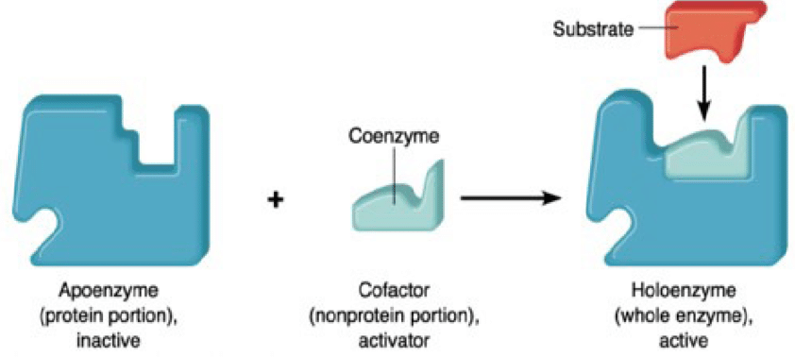

Slide 5
Cofactor :Anon- protein prosthetic group ,are generally metal iones that must be bound to the enzyme to maintain the correct configuration of the enzyme active site.
Metal cofactors may bound reversibly or tightly to enzymes. Reversible binding occurs in metal activated enzymes (e.g. magnesium in kinases and
phosphotransferase).
Coenzymes -. Are organic groups that generally serve as carriers of electrons or chemical groups. its a non protein, low Mwt, heat stable substance binding loosely with the enzyme and regenerated after the reaction.
Examples : Nicotine amideadeninedinucleotide(NAD).

Slide 6
Enzymes in clinical medicine
1-Diagnosis and prognosis of diseases
Changes in concentration and activity of plasma enzymes reflect changes that have occurred in a particular tissue or organ.
Plasma enzymes are of two types:
1-Functional enzymes: synthesized in the liver and present in the blood in high concentration .
2-Non-functional plasma enzymes:
intracellular enzymes present in very low levels in the blood (in healthy state) and has no function.
They are released in the plasma as a result of cellular damage (e.g myocardial infarction &hepatitis)

Slide 7
Non-Functional plasma enzymes | Functional plasma enzymes
Normally, present in plasma in very low concentrations in comparison to tissues | Present in plasma in higher concentrations in comparison to tissues | Concentration in plasma
No known functions | Have known functions | functions
Their substrates are absent from the blood | Their substrates are always present in the blood | substrates
Different organs e.g. liver, heart, brain and skeletal muscles | Liver | Site of synthesis
Different enzymes increase in different organ diseases | Decrease in liver diseases | Effect of diseases
ALT, AST, CK, LDH, alkaline phosphatase, acid phosphatase and amylase, | Clotting factors e.g. prothrombin,and ipoprotein lipase | Examples

Slide 8
Diagnostic Importance of Enzymes:
Plasma enzyme measurement is an important diagnostic tool for many diseases.
Examples:
A: CK-MB Isozyme in acute myocardial infarction.
B: Amylase in acute pancreatitis.
C: Acid phosphatase in prostatic cancer.
D: ALT, AST, γ-GT and alkaline phosphatase in liver
diseases.
Prognosis of the disease; we can follow up the effect of treatment by measuring plasma enzymes before and after treatment.

Slide 9
2-Some enzymes are used as Therapeutic agents
♥ Streptokinase:
Enzyme prepared from streptococcus
Used in clearing blood clots in myocardial infarction
Act by activating plasminogen to form plasmin.
Plasmin cleaves fibrin into several soluble components

Slide 10
♥ Asparaginase: enzyme used in therapy of adult leukemia ,.
Tumor cells have nutritional requirement for asparagine,
Asparginase is administrated decreasing asparagine level
Asparginase depresses the viability of tumor

Slide 11
3-Use of Enzymes in determination of Metabolites of clinical importance .
Determination of
Glucose oxidase glucose estimation
Uricase uric acid
Urease Urea
Cholesterol oxidase cholesterol
Lipase triglycerides
Enzymes used in ELISA ---technique .

Slide 12
4). To study the metabolic pathways in the body and their regulation.
5. The study of regulation of enzyme activity aid in understanding biochemical sciences and diseases such as:
Cancer
Heart disease
Hormone action
Drug action.

Slide 13
General Properties of Enzymatic Reactions
1. Enzymes have enormous ( very high) catalytic power.
Example :
Carbonic anhydrase
CO₂ + H₂O H₂CO₃
The enzyme can hydrate 10⁵ Co₂ molecules in one second , and the enzyme – catalysed reaction is 10⁷ faster than the uncatalysed one.

Slide 14
2. Enzymes are highly specific.
The ability of an enzyme to catalyze a particular reaction of a compound or class of a compounds is called its Specificity.
Types of enzyme specificity:
Stereospecificity
Reaction specificity
Substrate specificity :
1-Absolute substrate specificity
2-Relative substrate specificity

Slide 15
Stereospecificity or optical specificity
Stereoisomers are the compounds which have the same molecular formula, but differ in their structural configuration
The enzymes act only on one isomer and, therefore, exhibit stereo specificity.
Most of the enzymes of the human body show stereochemical specificity .Because we use only D-sugare and L-amino acids,the enzymes involved in digestion and metabolism recognize only those particular stereoisomers.

Slide 16
Reaction specificity
The same substrate can undergo different types of reactions, each catalysed by a separate enzyme and this is referred to as reaction specificity.
An amino acid can undergo transamination, oxidative deamination, decarboxylation, etc.
The enzymes however, are different for each of these reactions.

Slide 17
Substrate specificity
Absolute substrate specificity:
Certain enzymes act only on one substrate e.g. glucokinase acts on glucose to give glucose 6 - phosphate, urease cleaves urea to ammonia and carbon dioxide

Slide 18
Relative substrate specificity
In this type the enzyme act on more than one substrate
A-Bond Specificity:
In this type, enzyme acts on substrates that are similar in structure and contain the same type of bond.
Most of the proteolytic enzymes are showing group
(bond) specificity.
E.g. Amylase which acts on α-1-4 glycosidic ,bond in
starch ,dextrin and glycogen, shows bond specificity.

Slide 19
Group Specificity:
In this type of specificity, the enzyme is
specific not only to the type of bond but also to the structure surrounding it.
Example: Pepsin is an endopeptidase enzyme, that hydrolyzes central peptide bonds in which the amino group belongs to aromatic
amino acids e. g phenyl alanine, tyrosine and tryptophan.

Slide 20
3. Enzymatic reactions are generally reversible.
Most enzymatic reactions in the body are reversible. However, reactions in rate- limiting steps in the metabolic pathways are irreversible to control these pathways.

Slide 21
4. Enzymes reduces the activation energy of chemical reactions.
Example: a reaction A B
This reaction occurs when certain fraction of " A " molecules at any given instant posses enough energy to attain an activated state called Transition state, at which the probability is very high that a chemical bond is made or broken to the product ( P) . This state is at the top of the barrier of energy separating the reactants and products.

Slide 22
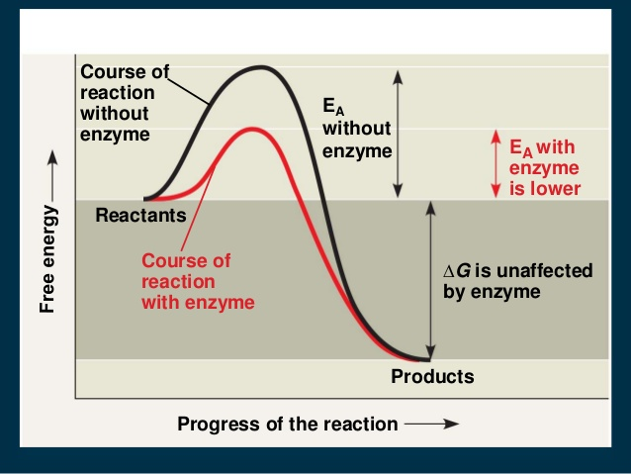

Slide 23
The free energy of activation ( ∆ G‡ ) is the amount of energy required to bring all molecules in one mole of a substance at given temperature to transition state at the top of energy barrier.
Enzymes combine transiently with reactants to produce a transition state having lower energy of activation than that of uncatalyzed reaction.
Thus , enzymes accelerate chemical reactions by lowering activation energy .

Slide 24
5. Enzymes does not alter reaction equilibrium.
Example:
A + B C + D
K= [ C ] [ D ] K :equilibrium constant
[ A ] [ B ]
Enzymes does not change " K " of the reaction, but reduces the time required to attain equilibrium.

Slide 25
6. Enzymes transforms different kinds of energy.
7. Enzyme activity is precisely regulated.

